Slide 1

Code Refactoring and Bug Fixing

Slide 2
About me
I am Shweta Kulkarni completed Graduation on B.E Civil
I have always been fascinated by the idea of programming and coding. Although I did not graduate in CS or IT, I have worked on my technical skills.
Yes , I have 5 Years of experience in Civil Engineering companies.
Linkedin profile urls – https://www.linkedin.com/in/shwetakulkarnii/
Github profile urls - https://github.com/SHWETADKULKARNI

Slide 3
Task:
Refactor the existing codebase and ensure the proper functioning of the Note Taking Application. Document all identified bugs during the debugging process. Remember, the task is not about recreating the app from scratch. Your goal is to fix the already existing codebase and make the application work as intended.

Slide 4
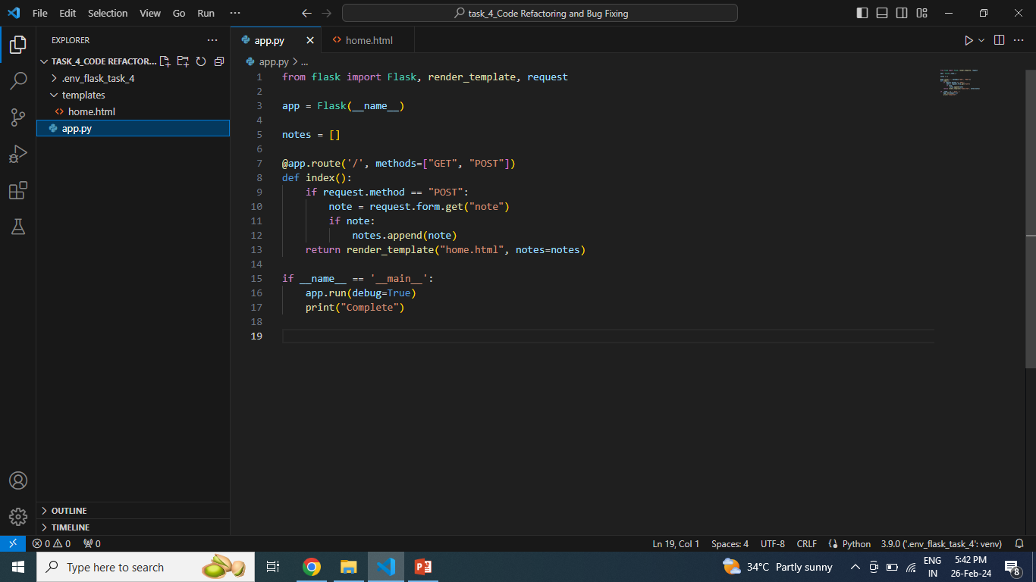

Slide 5
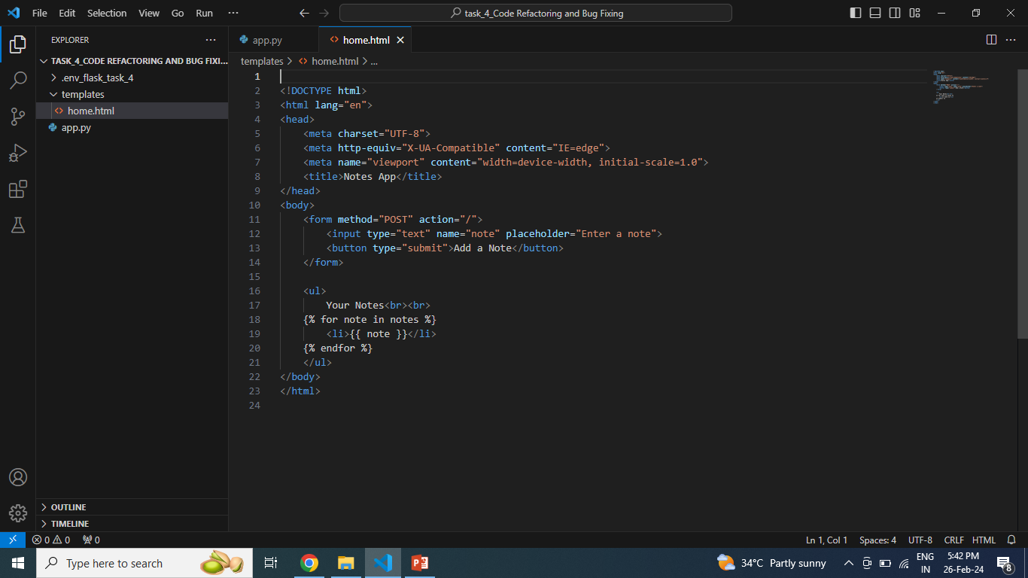

Slide 6
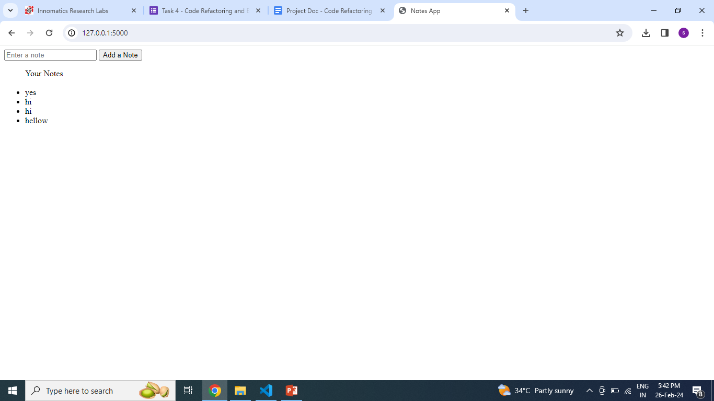

Slide 7

THANK YOU

